Slide 1
Multimedia Systems
Dr Laura Toni
l.toni@ucl.ac.uk
University College London

Slide 2
Today Lecture
Introduction to Information compression
Source Coding
Information and Entropy
Variable length coding
Quantization
Multimedia Systems
Image and Lossy Compression
Transforms
JPEG Quantization
JPEG Lossless Compression
Video Compression
Motion Compensation

Slide 3
Compressing Digital Video
Exploit temporal redundancy between frames
Only the sun has changed position between these 2 frames
Exploit spatial redundancy within frames (like JPEG: transform, quantize, Variable Length Coding)
Previous Frame
Current Frame

Slide 4
Difference Frames
Differences between two frames can be caused by
Camera motion: the outlines of background or stationary objects can be seen in the Diff Image
Object motion: the outlines of moving objects can be seen in the Diff Image
Illumination changes (sun rising, headlights, etc.)
Noise
Scene cuts
This difference might still have some correlation – we want to remove it with compression

Slide 5
Types of Motion: Translation
Translational motion: simple movement of typically rigid objects
Camera pans vs. movement of objects
Frame n
Frame n+1

Slide 6
Types of Motion: Rotation & Zoom
Rotation: spinning about an axis
Camera versus object rotation
Zooms – zoom in, zoom out
Camera zoom vs. object zoom (movement in and out)
Frame n
Frame n+1 (Rotation)
Frame n+2 (Zoom)

Slide 7
Motion Estimation
For some portion of the frame, estimate its movement between 2 frames- the current frame and the reference frame
What is some portion?
Individual pixels (all of them)?
Lines/edges (have to find them first)
Objects (must define them)
Uniform regions (just chop up the frame)

Slide 8
Motion Vectors
A motion vector (MV) describes the offset between the location of the block being coded (in the current frame) and the location of the best-match block in the reference frame
T=1 (reference)
T=2 (current)

Slide 9
Motion Compensation
This glued together frame is called the motion compensated frame
The encoder can also form the difference between the motion compensated frame and the actual frame.
This is called the motion compensated difference frame
This difference frame formed using MC should have less correlation between pixels than the difference frame formed without using MC

Slide 10
Motion compensated difference frames
Reference Frame F(n-1)
Original Frame F(n)
Difference Image E₁=F(n)-F(n-1)
Motion compensated frame M(n)
Motion compensated difference image E₂=F(n) – M(n)
E₁ & E₂ called prediction error or difference frames
Do we prefer to compress and send E₁ or MV+E₂ ?

Slide 11
Motion estimation philosophy
Most of the time, for a given representation quality
fewer bits to send MV+E₂ instead of sending E₁
fewer bits to send E₁ instead of sending F itself.

Slide 12
Reference Frame
0 1 2 3

Slide 13
Temporal Location of Reference

Slide 14
Thank You

Slide 15
Today Lecture
Introduction to Information compression
Source Coding
Information and Entropy
Variable length coding
Quantization
Multimedia Systems
Image and Lossy Compression
Transforms
JPEG Quantization
JPEG Lossless Compression
Video Compression
Motion Compensation

Slide 16
MPEG Frame Types
Intra (I) pictures: coded by themselves, as still images. No temporal coding. No motion vectors.

Slide 17
MPEG Frame Types
Forward Motion Compensated predicted (P) pictures – forward motion compensated from the previous I or P frame

Slide 18
MPEG Frame Types
Motion Compensated interpolated (B) pictures – forward, backward, and interpolatively motion compensated from previous/next I/P frames

Slide 19
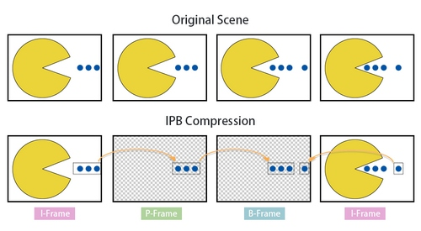
I-P-B Structure - example
Graphical example that shows how in P and B frames we actually only compress the “difference” with respect to one (or more) reference frame

Slide 20
I-P-B Structure - example

Slide 21
History of Video Compression Standards
Compression ratio
Full-HD mobile broadcasting
Ultra- HD (4K/8K) broadcasting
1/100
HEVC
Video Streaming
HD DVD
1/50
MPEG-4
1/25
MPEG-2
DVD
Digital TV
MPEG-1
Video CD
VideoConference
1991
1994
2003
2013
time

Slide 22




Competing Codecs
VP8/VP9,
AV1
MPEG/ITU HEVC/H.265
use scalar or vector quantization
use temporal compression
highly asymmetric
4K full-HD videos
Compression up to 50% compared to previous codecs

Slide 23

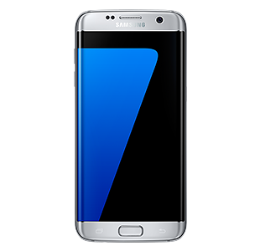

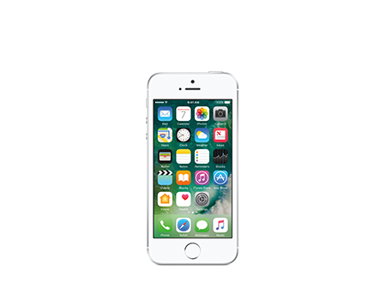
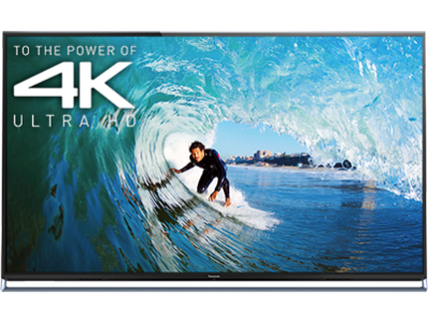

Competing Codecs
VP8/VP9,
AV1
MPEG/ITU HEVC/H.265

Slide 24
Performance comparison
“Rate-distortion performance of contemporary video codecs: Comparison of Google/WebM VP8, AVC/H. 264, and HEVC TMuC”, E Ohwovoriole and Y Andreopoulos - LENS Symp., London, 2010.
http://www.ee.ucl.ac.uk/~iandreop/OHWOVORIOLE_LCS_2010_H264_VP8_HEVC_comparison.pdf

Slide 25
Raw Bandwidth
Raw Bandwidth = color depths * W * L * refresh frequency
Resolution (WxL) | 24bit@25fps | 8bit@25fps | 8bit@15fps | 8bit@5fps
4K (3840x2160) | 5 Gbit/s | 1.6 Gbit/s | 995 Mbit/s | 331 Mbit/s
HDTV (1920x1080) | 1.3 Gbit/s | 414 Mbit/s | 248 Mbit/s | 83 Mbit/s
VGA (640x480) | 184 Mbit/s | 61 Mbit/s | 36 Mbit/s | 12 Mbit/s
SCIF (704x576) | 240 Mbit/s | 80 Mbit/s | 48 Mbit/s | 16 Mbit/s
CIF (352x288) | 60 Mbit/s | 60 Mbit/s | 12 Mbit/s | 4 Mbit/s
QCIF (176x144) | 12 Mbit/s | 12 Mbit/s | 3 Mbit/s | 1 Mbit/s
Uncompressed video is BIG
A DVD would hold max 5 secs of uncompressed video at 1920x1080 resolution
6 MHz channel for transmission therefore maximum possible bitrate is 18 Mb/sec
Requires compression of 83:1

Slide 26
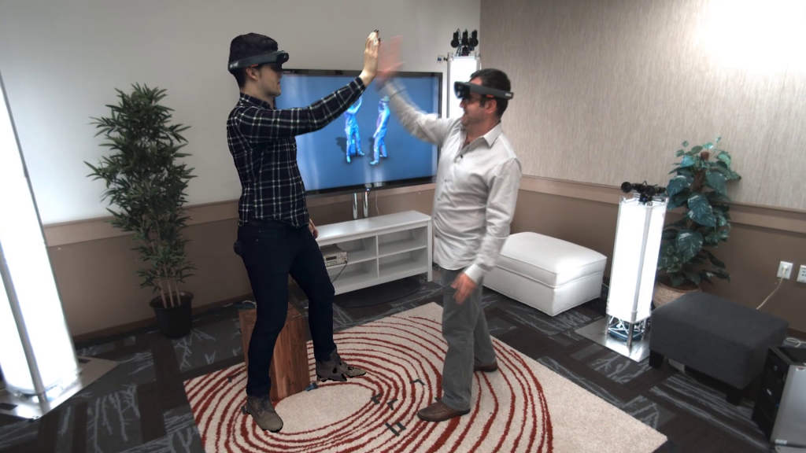
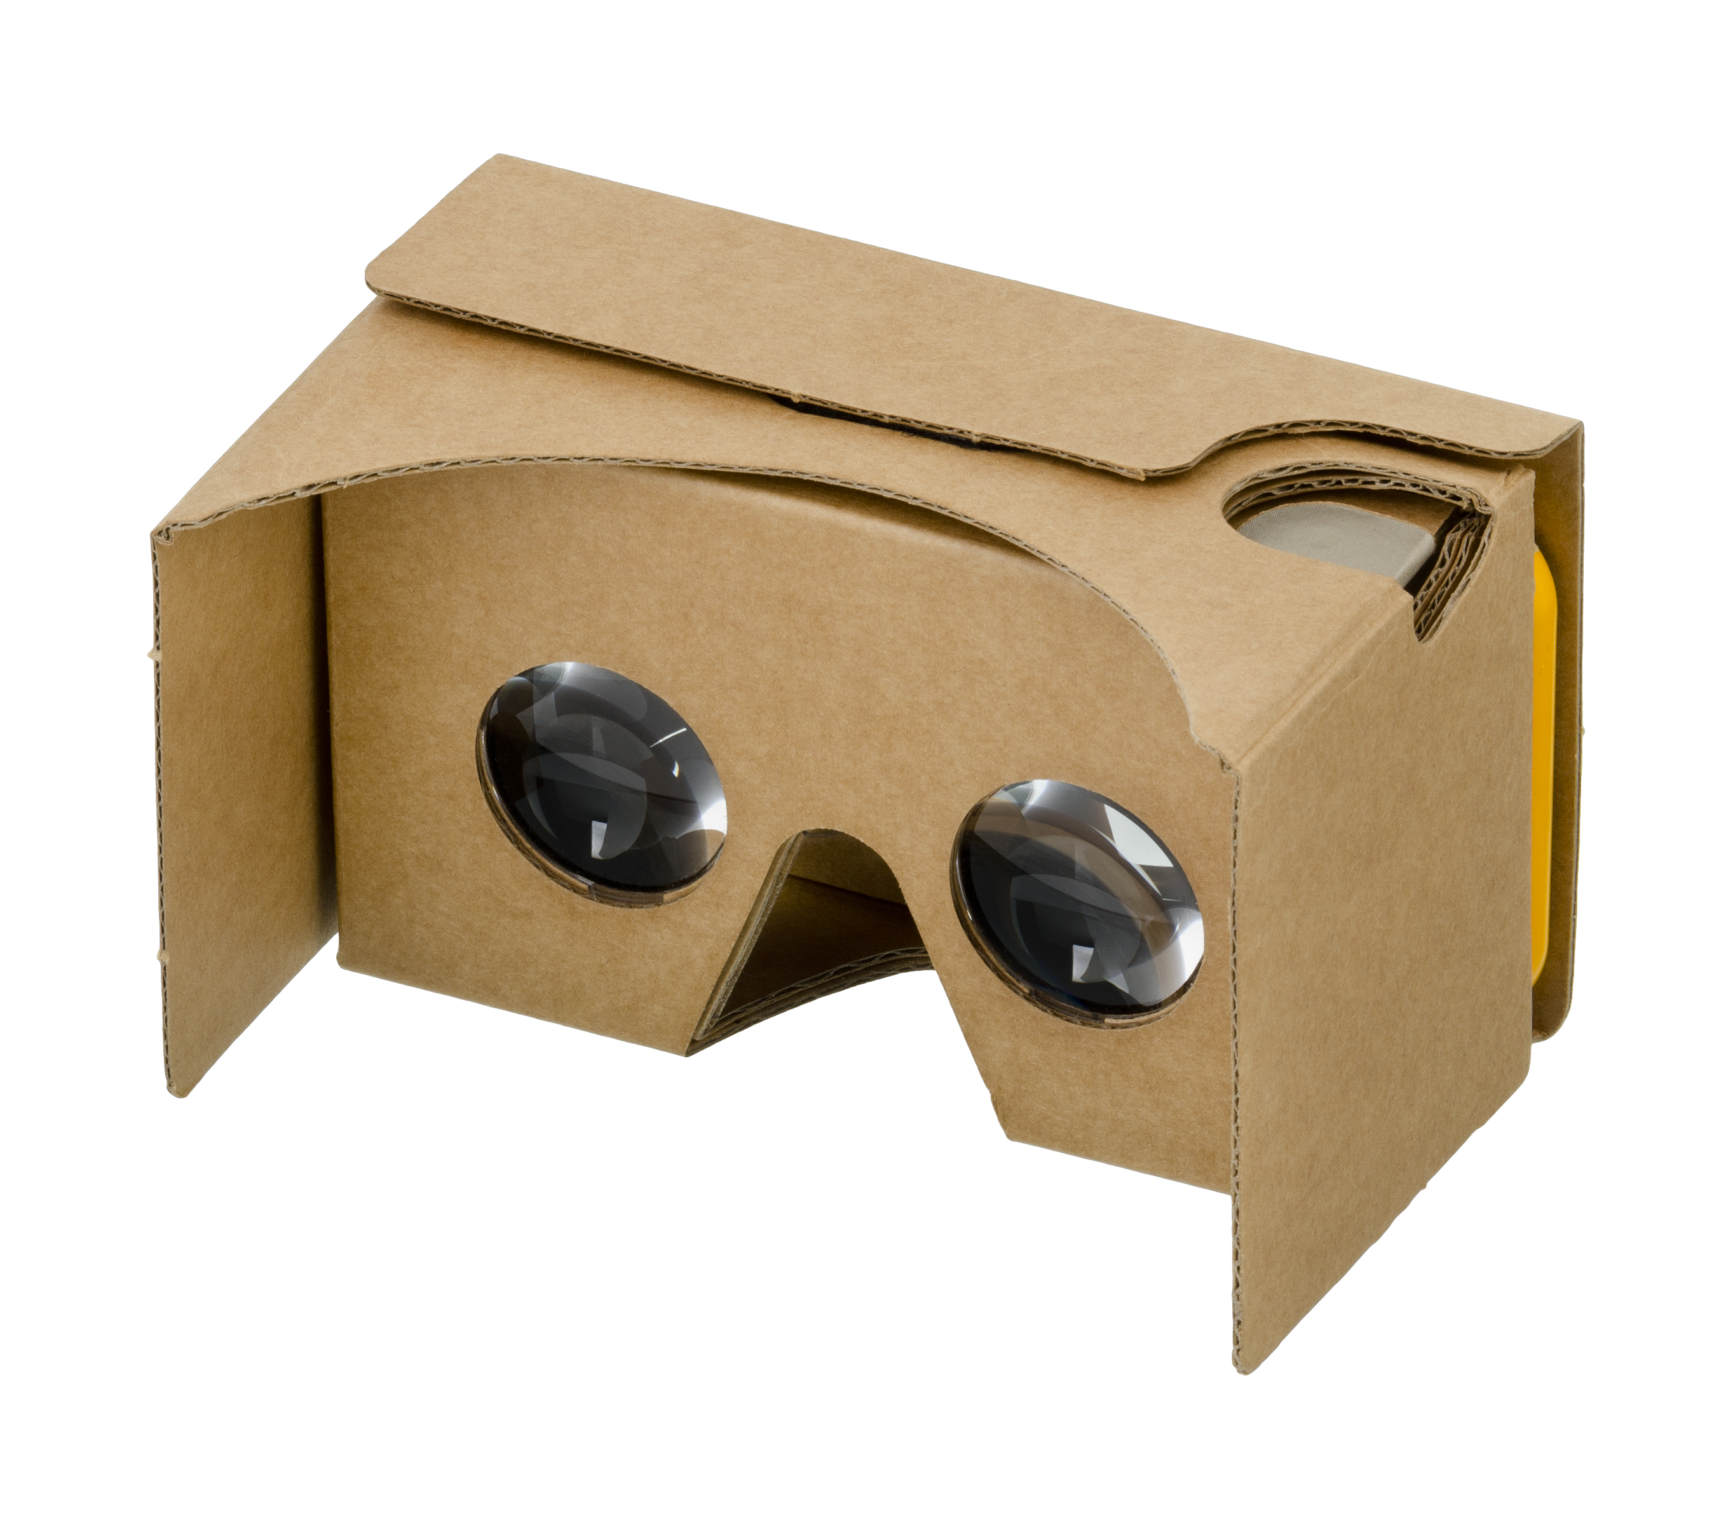
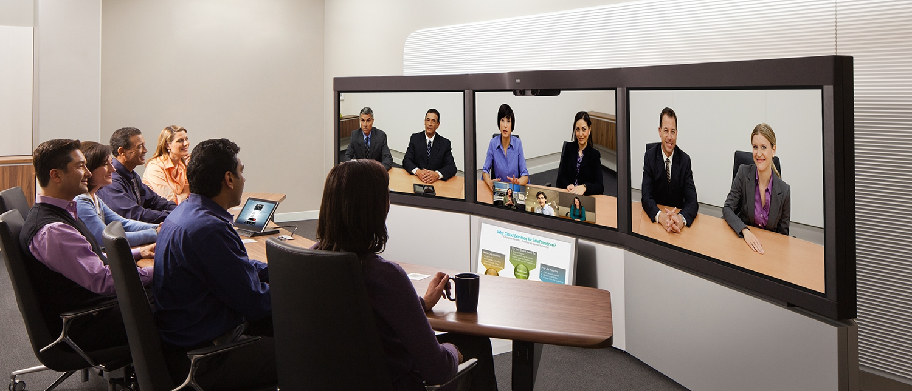
Future Video Applications
Immersive Communications (holoportation, from Microsoft)
Virtual Reality, 360 Videos
Telepresence
(from Cisco)

Slide 27
Speech/Audio/Video Coding Summary
Requirements for Coding of each Source
Speech Coding Principle
Discontinuous Transmission
GSM Speech Coding
RPE-LPC
Enhanced Full Rate
Different Video Coding Formats, motion compensation

Slide 28
Web References
3G Latest
http://www.umts-forum.org/
GSM Information
http://www.gsmworld.com/
Fraunhofer Full-HD Voice
http://www.full-hd-voice.com/
MPEG Information
http://www.chiariglione.org/mpeg/
Speech Coding
http://www-mobile.ecs.soton.ac.uk/speech_codecs/
Netflix TechBlog
http://techblog.netflix.com/search/label/encoding

